Slide 1
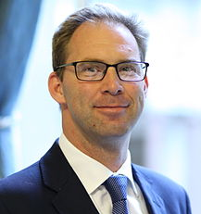
HEROES AND
HELPERS
Presenter Name: Name of School:
KL Education Consultants

Slide 2
WHAT
IS TERRORISM?

Slide 3
UK Terrorism Act, 2000
An act of terrorism is
“….an act or threat of act that is designed to influence the government or to intimidate the public or a section of the public which is made to advance a political, religious or ideological cause”
SUCH ACTS MAY:
Involve serious violence against a person
Involve serious damage to property
Endanger another person's life
Create a serious risk to the health or safety of the public
Seriously interfere with or disrupt an electronic system

Slide 4
WHAT CAUSES TERRORISM?
UNABLE OR UNWILLING TO BRING ABOUT CHANGE PEACEFULLY?
POVERTY?
EXTREME RELIGIOUS OR POLITICAL BELIEFS?
FEAR AND SUSPICION OF THOSE WITH DIFFERENT RELIGIOUS AND POLITICAL BELIEFS?
LACK OF EDUCATION?
SOCIAL AND POLITICAL INEQUALITY AND INJUSTICE?

Slide 5
Mr. ROGERS
“When I was a boy and I would see scary things in the news, my mother would say to me, "Look for the helpers. You will always find people who are helping." To this day, especially in times of "disaster," I remember my mother's words and I am always comforted by realising that there are still so many helpers, so many caring people in this world.”

Slide 6
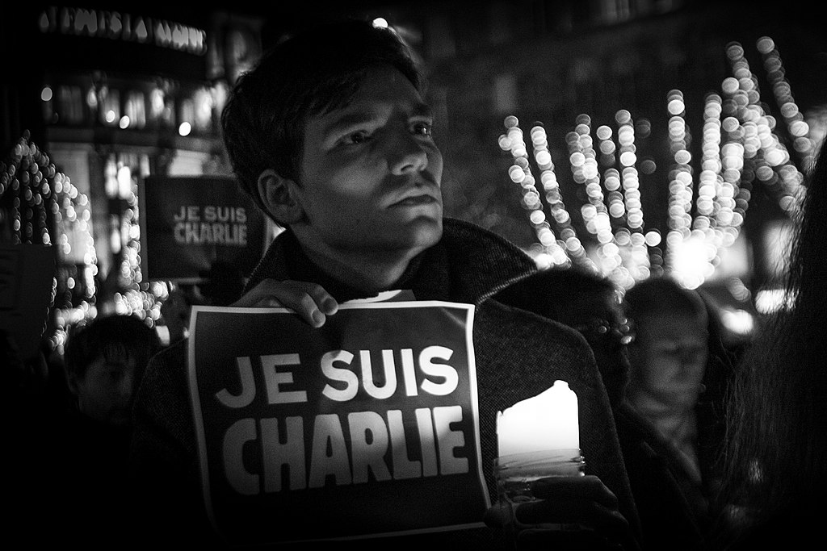
Our Core Values
#together
© Claude Truong-Ngoc / Wikimedia Commons

Slide 7
WHO CAN I TALK TO ABOUT MY CONCERNS?
A friend or family member
The Child Protection Officer
Your tutor, Head of Year or another teacher you trust
You can call Childline and speak to someone anonymously on 0800 1111 or chat to them online at www.childline.org.uk
You can call the Police to discuss non-emergency concerns on 101

Slide 8
SEPTEMBER 11TH 2001, NEW YORK
Library of Congress, Prints & Photographs Division, photograph by Don Halasy, [reproduction number, e.g., LC-USZ62-123456]

Slide 9
MARCH 22ND, 2017 - WESTMINSTER BRIDGE

Slide 10
AFTER THE BATACLAN ATTACK IN PARIS, 2015

