Slide 1
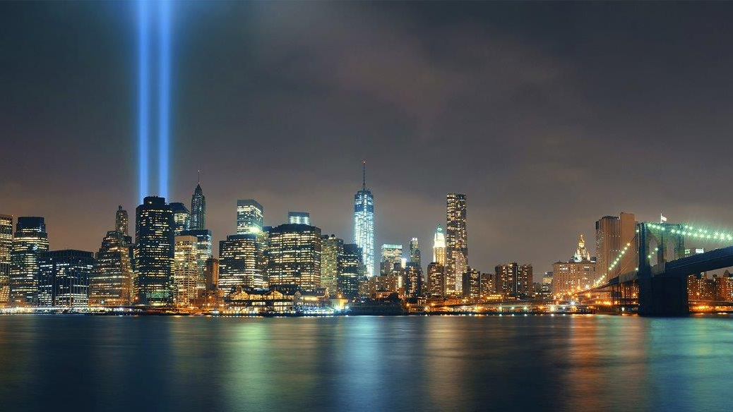

9/11 CHANGED THE WORLD
Schools Assembly Pack

Slide 2

HELPING TEACHERS EXPLAIN WHAT HAPPENED
on September 11th 2001
Introduction
What happened
How others came to help
The heroes and helpers
Interview with Tom Von Essen. Commissioner of the Fire Dept of NY on the day
We can still help
Making sense of what happened
That's where SINCE 9/11 comes in.

Slide 3
1. HELPING TEACHERS EXPLAIN WHAT HAPPENED
on September 11th 2001
None of the pupils in your school were born in September 2001, and on the occasion of the twenty-fourth anniversary many will be wondering what happened that day and why it happened. They may have questions about the day itself or about what relevance it has to them today.
This presentation pack, along with the accompanying FAQ sheet will provide you with content for an assembly or the basis for discussion. You can choose which elements are best suited for your school. Should you or your pupils have further questions you will find links to helpful resources at the end of the document.
That's where SINCE 9/11 comes in.

Slide 4
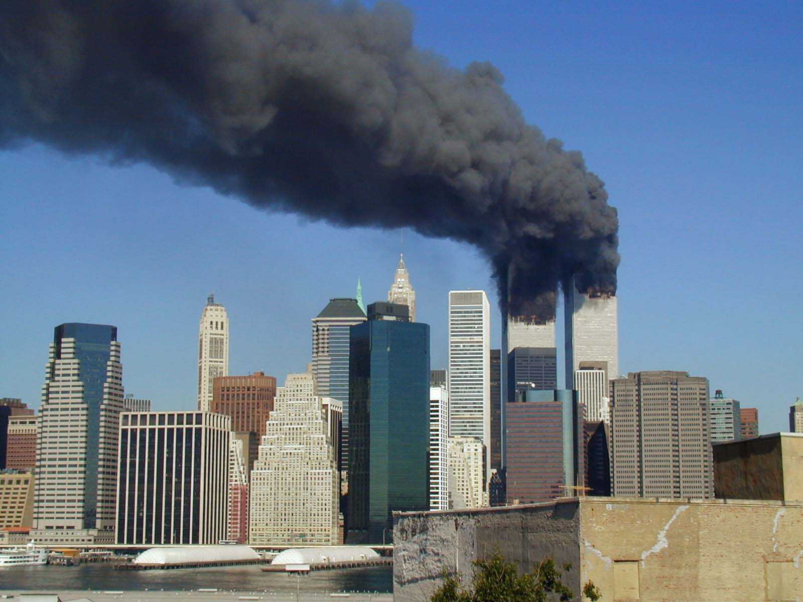
2.WHAT HAPPENED
on September 11th 2001?
FOOTAGE OF THE SECOND PLANE STRIKING THE WORLD TRADE CENTRE

Slide 5
2.WHAT HAPPENED
on September 11th 2001?
On 11th September 2001, terrorists hijacked planes and flew them into the twin towers of the World Trade Center in New York and the Pentagon (a fourth plane was crashed in Pennsylvania), together killing 2,977 people. To this day, 9/11 remains the world’s most fatal terrorist event in recent times.
It’s worth reminding ourselves that no child in school today was alive when these events occurred, however they are all familiar with images, videos and conspiracy theories shared on social media.
The terrorist attacks that happened in 2001 shocked the world. To many, it felt as if they had come out of the blue; the USA had never been subject to this kind of terrorist attack before. The scale of the attack was difficult to take in and it was viewed worldwide on television as it was taking place. When it happened, it felt like the end of the world and no one knew when the attacks would stop or who might be next. Many people said they felt it bore a terrible similarity to many disaster movies...except that this was for real.
But the events of September 11th didn’t happen in isolation, and for those who were studying global political events, there were lots of signs that these attacks were on the cards.
That's where SINCE 9/11 comes in.

Slide 6
WHAT HAPPENED
on September 11th 2001?
It’s also important to remember extremism based on religion and beliefs has been used to justify violence against people throughout history, and these acts are not the sole preserve of extremist Muslim groups.
Sadly, there have been many other examples of violent extremist acts, for example, the Hanau shootings that took place in February 2020, when 11 people were killed and five others wounded in a terrorist shooting spree by a far-right extremist in Frankfurt, Hesse, Germany. Another example was in 2016 when Jo Cox, the Member of Parliament (MP) for the Batley and Spen constituency was murdered by Thomas Mair, who was motivated by extreme right-wing ideology.
TERRORISM TIMELINE
That's where SINCE 9/11 comes in.

Slide 7
3.WE CAN FIND COMFORT IN HOW OTHERS CAME TO HELP
on September 11th 2001
You’ll know this from times in your own life. When someone you love gets sick, you will have doctors and nurses who help that person get better again, or make them more comfortable so they can die with dignity. Whenever one of our school buses break down, people passing in the street will stop to see if the driver is okay, then mechanics send out a pick-up truck, and (teacher at school) makes sure everyone gets home safely.
This can be really comforting to think about – no matter how bad times get, look out for the helpers, because their actions remind us of the kindness of humanity.
That's where SINCE 9/11 comes in.

Slide 8
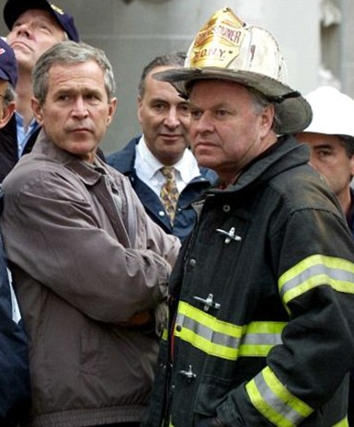
4.The heroes and helpers
on September 11th 2001
Although 9/11 will always be remembered with sadness, there were also acts of extreme bravery and courage.
The actions of the fire department will always be particularly remembered. 343 Firefighters were amongst those who lost their lives that day.
Interview with Tom Von Essen, Retired Commissioner, FDNY ­– New York City Fire Department who was in charge at the time.
If you can’t play the video the ‘read aloud’ version is laid out over the next pages
That's where SINCE 9/11 comes in.
George W Bush with Tom Von Essen

Slide 9
5.TOM VON ESSEN. COMMISSIONER FDNY
on September 11th 2001
“On September 11 I was on my way to work, driving down the East River Drive. I got a call that the North Tower was hit by a small plane. As I was walking in, I couldn’t see anything, it was so far up. As you get up close to a big building like that you really can’t see anything so far up. But I felt a thud. I could feel it. About 10ft away from me there was a person who had been driven out by the flames on the upper floors.
It immediately startled me, of course. You feel the sense of pain that person must have been going through. The windows were already out on the first floor, and as I got into the lobby the chiefs had already made a decision. They couldn’t put the fire out because there were no water lines on the upper floors – they had been destroyed by the impact of the plane crash. Which didn’t make sense – it was a small plane.
So, the main concern would be to try to rescue as many people as they could below the impact zone. Firefighters were moving quickly, not in panic, moving their way up the stairs.
And you could see on the faces at that time, on some of the older guys, a sense of… not fear but concern that this was gonna be a very tough operation
That's where SINCE 9/11 comes in.

Slide 10
5.TOM VON ESSEN. COMMISSIONER FDNY
on September 11th 2001
On the younger firefighters you could see a different look, a kinda excitement of the unknown, at being involved in an operation that would be talked about for a long time to come.
We were there a while, and we felt the vibration, a vibration we thought was an explosion on the upper floors. I went around the corner and an enormous sound of a violent rustling of debris and everything. And then the dust came right over us.
I ran into a lobby and waited a few minutes until I could see again.
When it first happened, you couldn’t even see, and your eyes were filling up. I started to walk a little further up, I had two of my guys with me, trying to get as much information as they could. They said the South Tower had fallen. I said, how many floors? And they said the entire building. I said it can’t be right, it has to be inaccurate. Try to get better information.
I couldn’t see anything at that point. The mayor said to me, how many of your guys will be in there? I said, I don’t know. I don’t know how many got far enough up. Of course, in the South Tower there was no warning because it was the second tower that was hit.
That's where SINCE 9/11 comes in.

Slide 11
5.TOM VON ESSEN. COMMISSIONER FDNY
on September 11th 2001
It was probably about 3 o’clock in the afternoon before I even talked to my wife. I felt pretty bad about that. Early reports were that I had been killed in the building and I never even called her. But as the day went by, we started to get reports of all the people that we lost. And it just got worse as the day went by. It just got worse.
You know as bad as the day of September 11th was, it just continued to become more painful as the weeks went by, because we started to deal then with the grief and the death and talking to young mothers and fathers of guys I knew who had lost their son, searching for their son.
For weeks we thought we’d find somebody trapped that we’d be able to rescue. Story after story… of a good friend who had two boys, his only two children, one was a hero police officer, another was a firefighter. Both of them lost that day. A woman whose husband was getting ready to retire, an old-timer, a son who had just came on the job. Both of them lost that day.
A woman I had helped get her husband through horrible, horrible burns about two or three years before that, finally gets back to full duty. I had encouraged him to retire, didn’t have to, we had a special boot for him and everything. He gets killed that day.
That's where SINCE 9/11 comes in.

Slide 12
6.WE CAN STILL HELP
on September 11th 2025
Today, we can still help, by remembering what happened and working to make sure it never happens again. It is important to remember the events of that day when the world changed for ever, and to keep in mind that we have all been affected by them in some way, even though it happened a long time ago.
Why does it matter? History matters, because by remembering the past we learn from the past, and then if we remember 9/11 we can all work together to try to prevent something like this from ever happening again.
That's where SINCE 9/11 comes in.

Slide 13
7.MAKING SENSE OF WHAT HAPPENED
on September 11th 2001
It’s totally normal to feel a little overwhelmed when you think about the events of 9/11. It would be impossible to ever truly understand the motivations of those behind the attacks, as much as it is hard to imagine how difficult it would have been for those who lost loved ones.
So what can you do? Sadly, there is lots of misinformation circulating about the events of 9/11.
Therefore what you can do is check that whatever you do read about it is factual. In this way we can honour those who lost their lives, and ensure we aren’t repeating untruths about those involved in the events. It’s really important that when you read news online you think about the importance of recognising where reporting biases can occur. A ‘reporting bias’ is where the person retelling the events has another motive beyond telling the story with just the facts.
This is why you should always consider the credibility of sources, and think critically about the motivation of reporters. Look for names of news organisations you recognise and trust, and make use of fact checking websites like ‘Full Fact’ to double check what you’ve read.
That's where SINCE 9/11 comes in.

Slide 14
MAKING SENSE OF WHAT HAPPENED
on September 11th 2001
Something to think about
Radio 4’s Thought for the day by Thomas McCarthy, OP:
‘This world is a complex place, not really the world my parents hoped for. It's changed. And yet we mustn't lose the capacity to dream, to have hope. Not to mention faith, which enables us to look beyond our failures. Faith allows us to dream of a future: even on the darkest nights, people dream. When tragedy obscures the Manhattan sky, we need to imagine a new world. And not for the first time.’
That's where SINCE 9/11 comes in.

Slide 15
THANK YOU
Visit www.since911.com to learn more about our work or contact us using the details below to find out more.
WWW.SINCE911.COM | @SINCE911UK | INFO@SINCE911.COM

