Slide 1
Artefacts

Slide 2
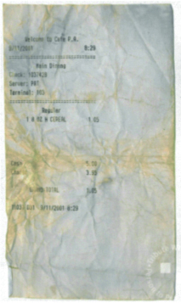
Historians use all sorts of sources to try to understand past events.
Here is an object from the past. Study it carefully and try to decide…
What is it?
What can it can tell you about the person who owned it?
Why do you think it has been kept rather than thrown away?
History | What made 9/11 so shocking?

Slide 3
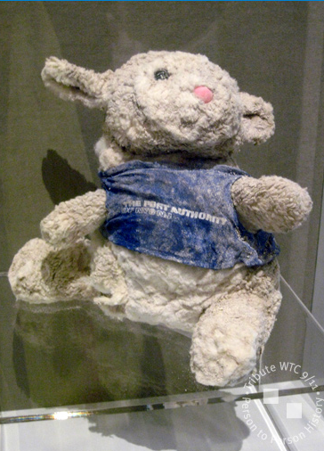
Can you link this (and the images on the next two slides) to the first object you saw?
History | What made 9/11 so shocking?

Slide 4
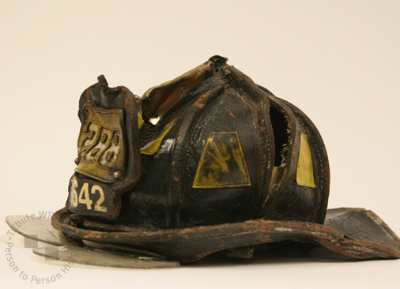
History | What made 9/11 so shocking?

Slide 5
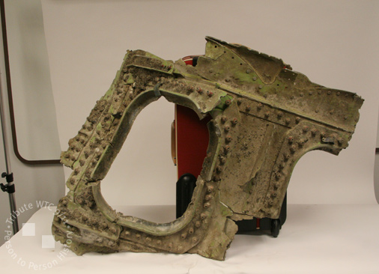
History | What made 9/11 so shocking?

Slide 6
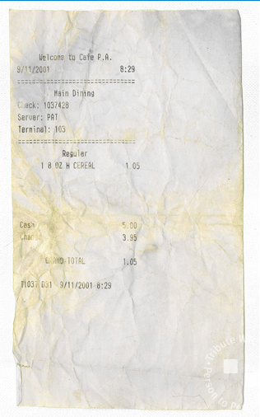
The object is a receipt from the cafeteria in the World Trade Center, run by the New York Port Authority.
The owner of the receipt is Peter Miller. Here is the story behind the object:
“I had purchased my breakfast at the World Trade Center cafeteria on the 43rd floor minutes before the first plane hit. Later I found the receipt in my wallet and realised that during my evacuation everything I was wearing and all of the items in my wallet had gotten saturated both from my sweat and from the sprinklers…”
Property of Peter Miller on loan to WTC Museum
History | What made 9/11 so shocking?

Slide 7
Subject | Session title

