Slide 1
Shockwave

Slide 2
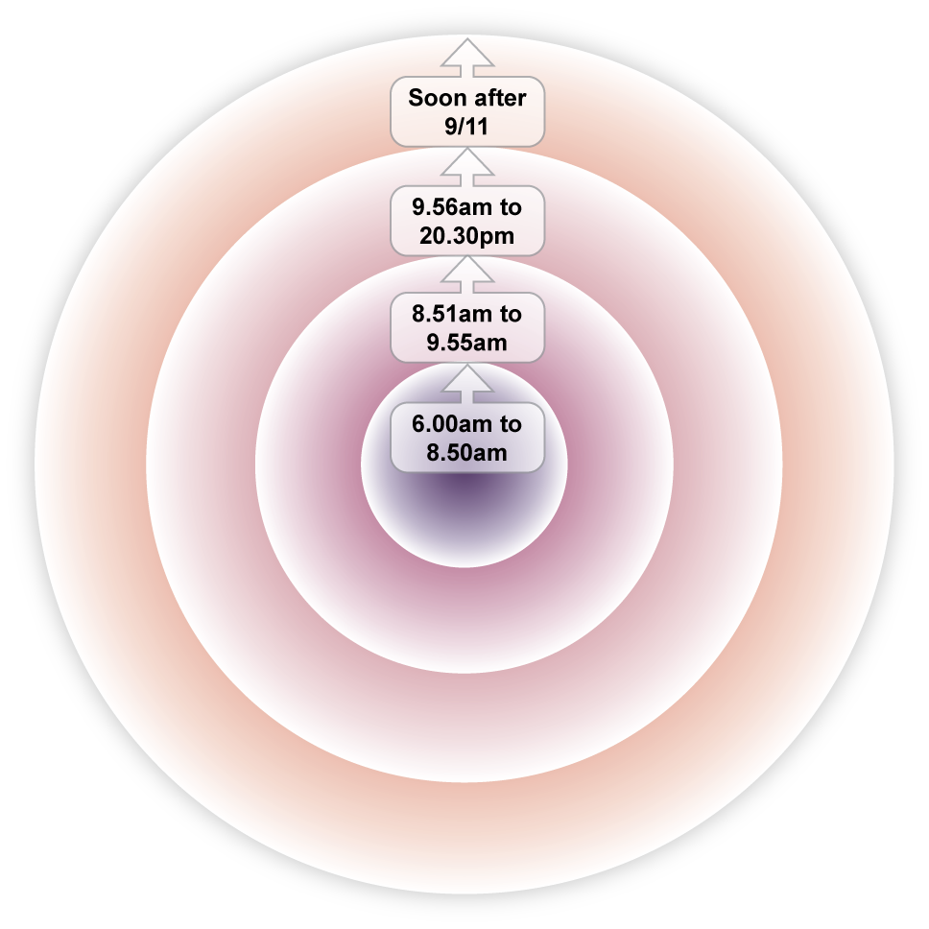
A ripple diagram Use this to show how different shockwaves spread on and soon after 9/11
History enquiry 1 | What made 9/11 so shocking?

Slide 3
In the days after 9/11…
Newspapers and television compared 9/11 to the Japanese attack on Pearl Harbour that led the USA into the long and bloody Second World War.
It emerged that several of the hijackers had been stopped and searched by airport security as they checked in for their flights on 9/11 They were still allowed to board the planes, despite setting off metal detectors.
History enquiry 1 | What made 9/11 so shocking?

Slide 4
In the days after 9/11…
The hijackers are believed to be members of an extreme Muslim terrorist group called Al-Qaeda, which has organised attacks on US troops and civilians many times before.
News reports from New York and around the world showed that the total of those who died in the attacks was nearly 3,000. Those who died included many foreigners as well as Americans and people of all sorts of religion including Muslims.
History enquiry 1 | What made 9/11 so shocking?

