Slide 1


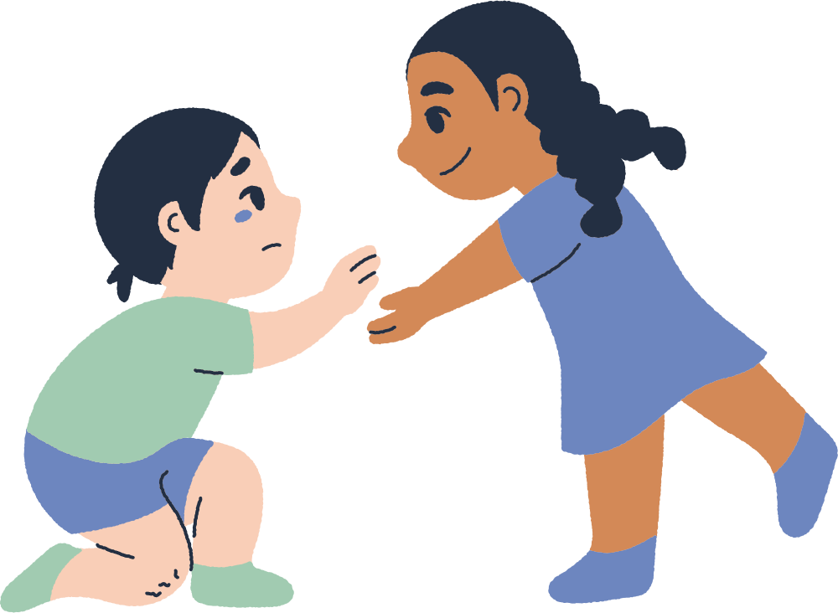


Kind Words
By SINCE 9/11
Why They Matter and What We Can Do

Slide 2

Let’s make the world a better place, one kind act at a time. Look at the pictures and think how being kind could make a differnce!

Slide 3
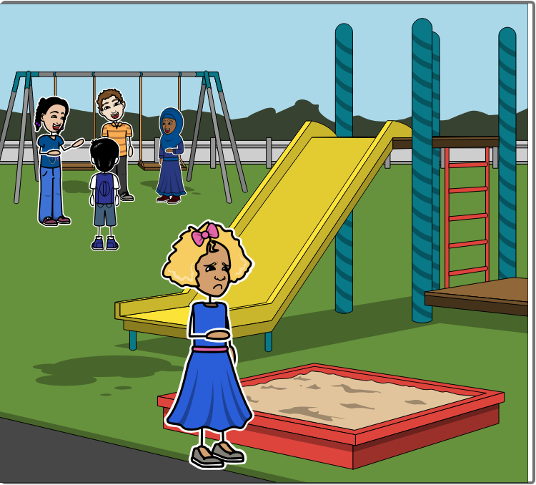
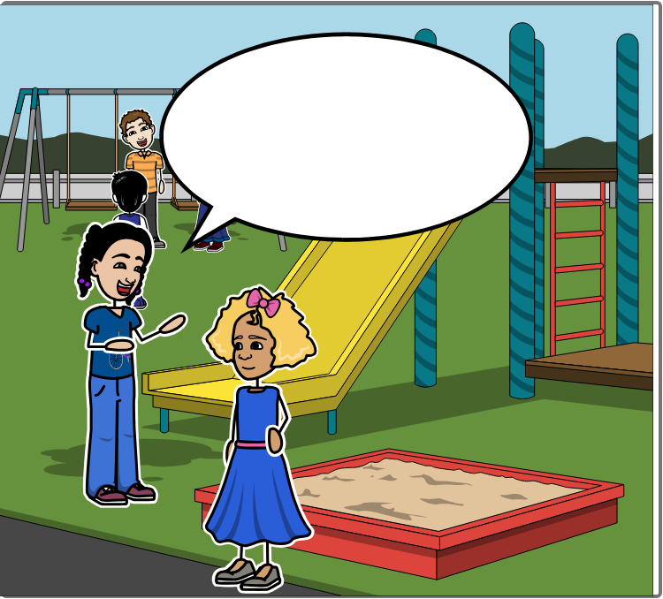

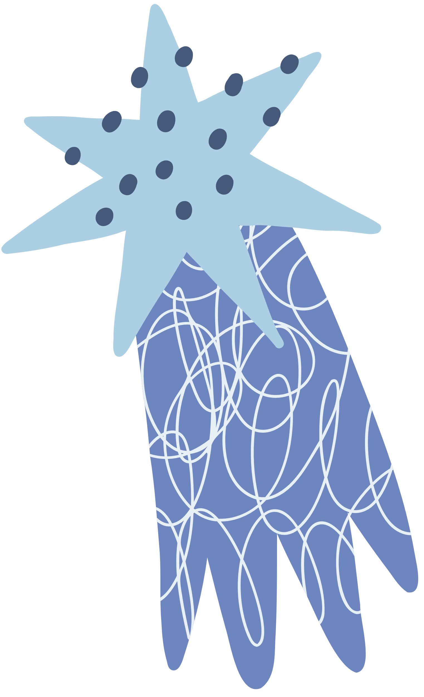
Someone is playing on their own at break time.
How do you think this makes them feel?
What’s the best way you think you can show kindness and help them?

Slide 4
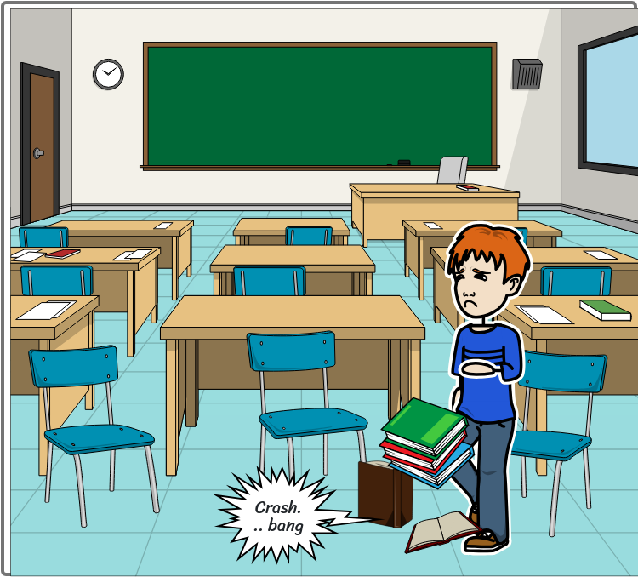
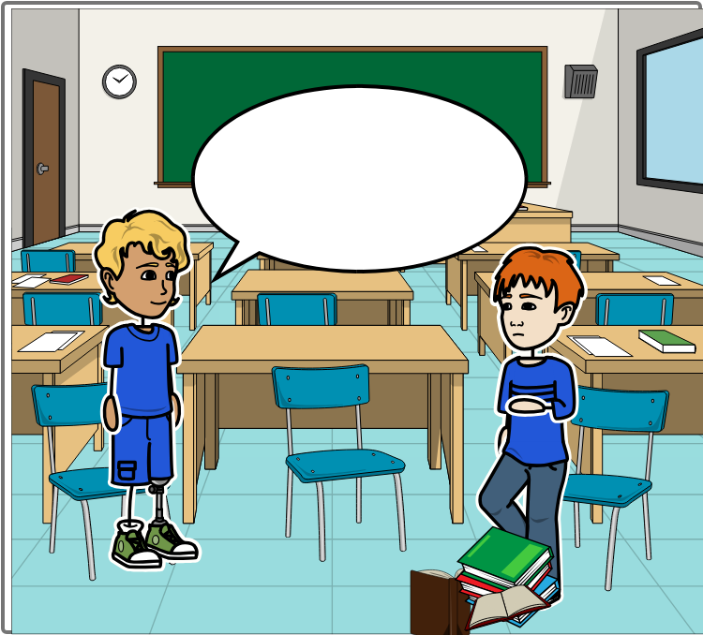
A classmate has dropped their books or belongings on the floor
How do you think this makes them feel?
What’s the best way you think you can show kindness and help them?

Slide 5
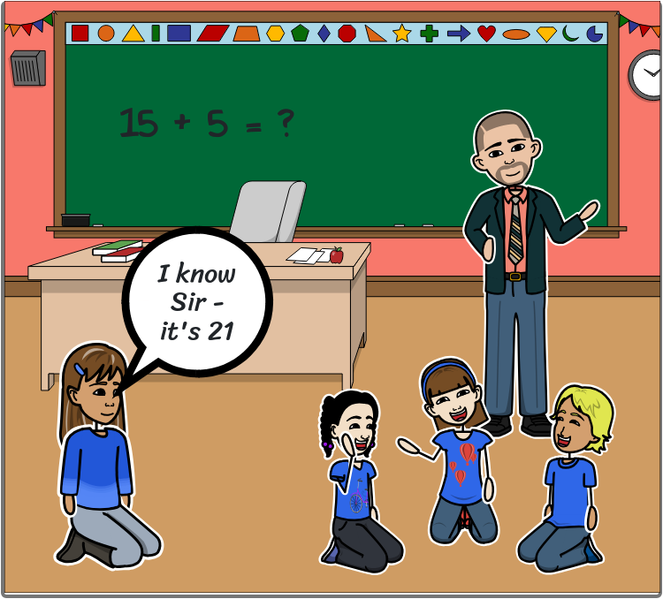
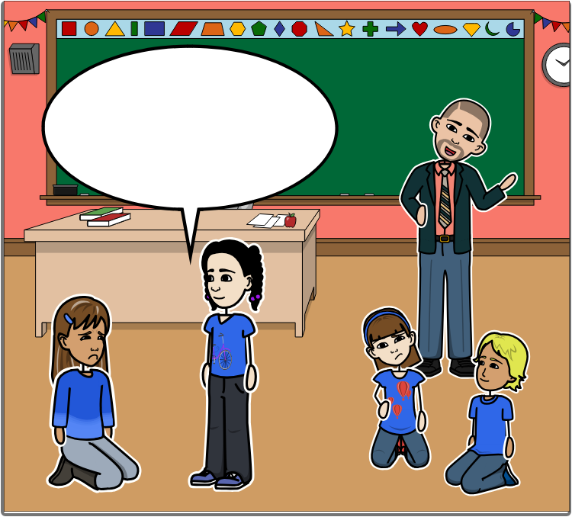
Someone makes a mistake and others start laughing
How do you think this makes them feel?
What’s the best way you think you can show kindness and help them?

Slide 6
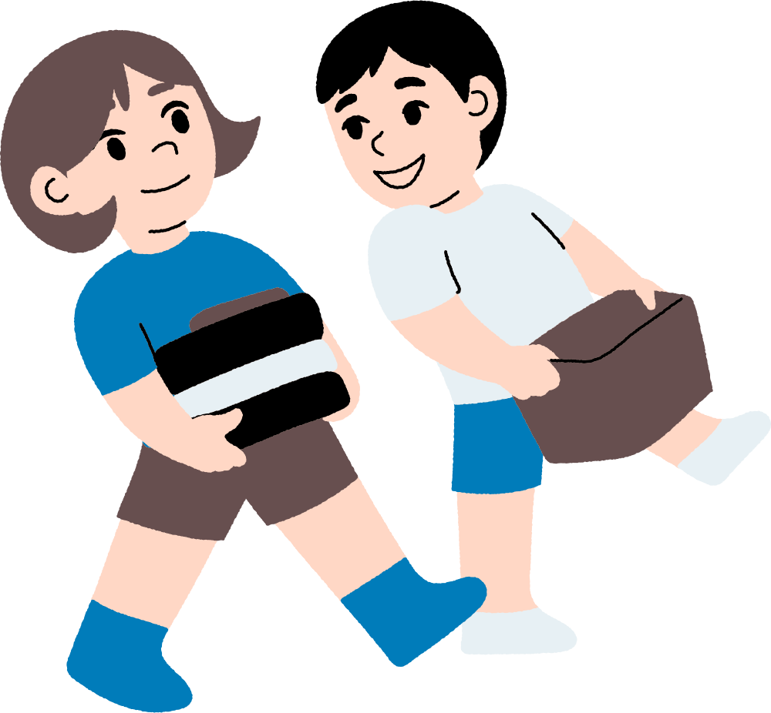
Kindness means being friendly, generous, and caring towards others.
So please always be kind!
What are some ways we can show kindness to others?

Slide 7


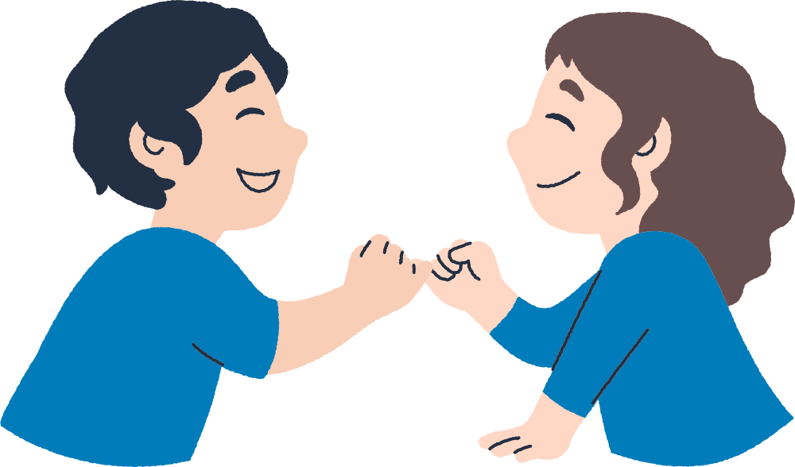
Please visit us for more on kindness
Click here to go to our other kindess resources and lessons
www.since911.com/kindness-connects/

